Slide 1
UNIT CONVERTER
PROGRAMMING FOR PROBLEM SOLVING
MINI PROJECT
Name:- Shaurya Mehrotra & aparna jaiswal
REG. NO.- RA2111003010365 & RA2111003010367
BRANCH:- Computer Science and Engineering(Core)
SECTION:- E1

Slide 2
ABOUT THE PROJECT
In today’s modernizing world where everybody wants to save time, this project comes handy in variety of ways. There are various situations such as temperature conversions, Weight/Mass Conversions and Length conversions, which this project can perform within seconds to save precious time of students doing long calculations which are tiresome and exhausting.

Slide 3
ABSTRACT
TEMPERATURE CONVERSION | WEIGHT/MASS CONVERSION | HEIGHT/LENGTH CONVERSION
3 Types of sub-conversions:- a.)Celsius to Fahrenheit b.)Fahrenheit to Celsius c.)Celsius to Kelvin | 2 Types of sub-conversions:- a.)Kilograms to Grams b.)Grams to Kilograms | 3 Types of sub-conversions:- a.)Feet to Inches b.)Inches to Feet c.) Inches to Centimeter
Formulas used:- Formulas used:- Formulas used:-
C= (F-32)/(5/9) G= KG*1000 Inches=Feet*12
F= (C*(9/5))+32 KG= G/1000 Feet=Inches/12
K= C+273.15 Cm=Inches*2.54

Slide 4
METHOD USED
a.) 3 type conversions are achieved through an outer and inner switch case(nested switch case).
b.)The outer switch case is used to access the 3 different type conversions namely Temperature, Mass, Height conversions.
c.)The inner switch case is used to access the types of sub-divisions each of the parent conversion hold.
d.)<math.h> header file used particularly in Mass/Weight conversion to divide and multiply Grams and Kilograms respectively.
e.)Goto() function is invoked in the program every time the an invalid choice is made. There are 4 goto() functions used and each takes you to the last checkpoint menu.

Slide 5
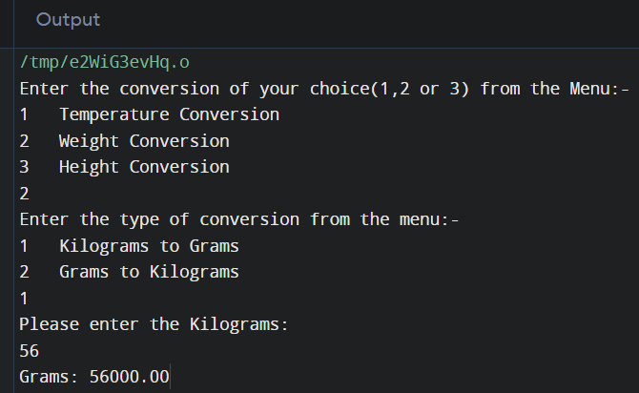
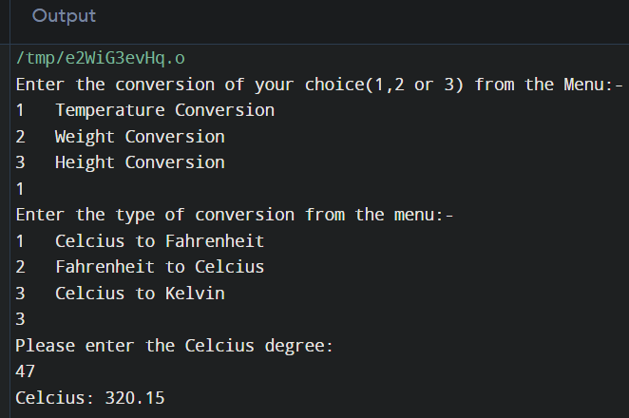
OUTCOME

Slide 6
THANK YOU

